Slide 1
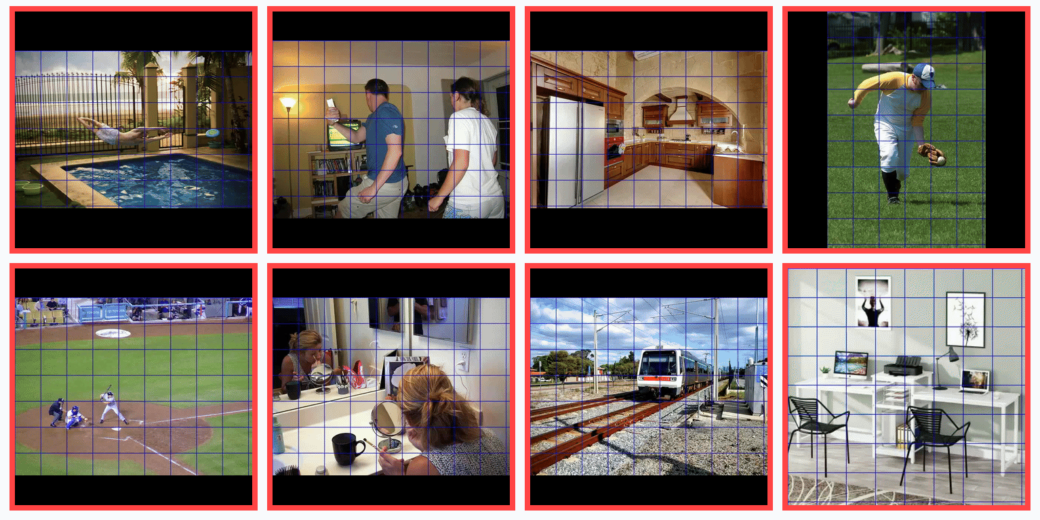
Constructive Distortion: Improving MLLMs with Attention-Guided Image Warping
Dwip Dalal¹, Gautam Vashishtha², Utkarsh Mishra³, Jeonghwan Kim¹, Madhav Kanda¹, Hyeonjeong Ha¹, Svetlana Lazebnik¹, Heng Ji¹, Unnat Jain⁴
Published at ICLR 2026
¹University of Illinois Urbana-Champaign, ²Skan AI, ³Texas A&M University, ⁴University of California, Irvine

Slide 2
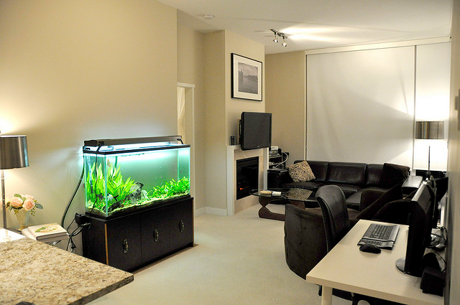

VLMs err when they shouldn’t
What device is below the artwork?
Is there a bottle in the image?
LLaVA: Speaker
❌
❌
Qwen: No
Liu, Haotian, Chunyuan Li, Yuheng Li, and Yong Jae Lee. "Improved baselines with visual instruction tuning." In CVPR 2024
Bai, Shuai, Keqin Chen, Xuejing Liu, Jialin Wang, Wenbin Ge, Sibo Song, Kai Dang et al. "Qwen2.5-vl technical report." arXiv preprint arXiv:2502.13923 (2025).

Slide 3
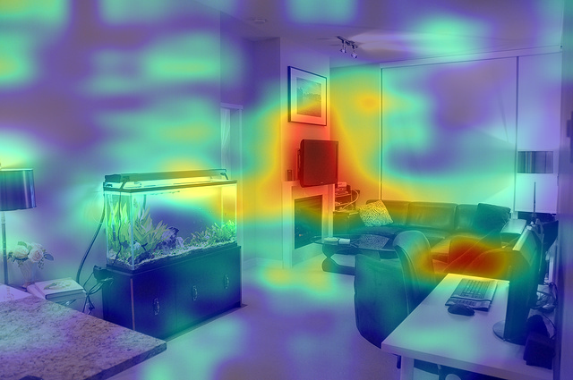

VLMs err when they shouldn’t
What device is below the artwork?
Is there a bottle in the image?
LLaVA: Speaker
❌
❌
Qwen: No
Liu, Haotian, Chunyuan Li, Yuheng Li, and Yong Jae Lee. "Improved baselines with visual instruction tuning." In CVPR 2024
Bai, Shuai, Keqin Chen, Xuejing Liu, Jialin Wang, Wenbin Ge, Sibo Song, Kai Dang et al. "Qwen2.5-vl technical report." arXiv preprint arXiv:2502.13923 (2025).

Slide 4
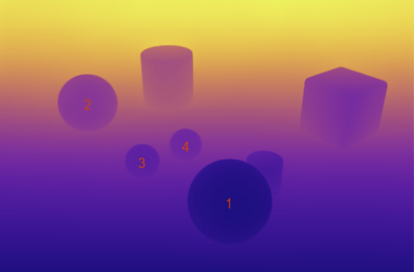

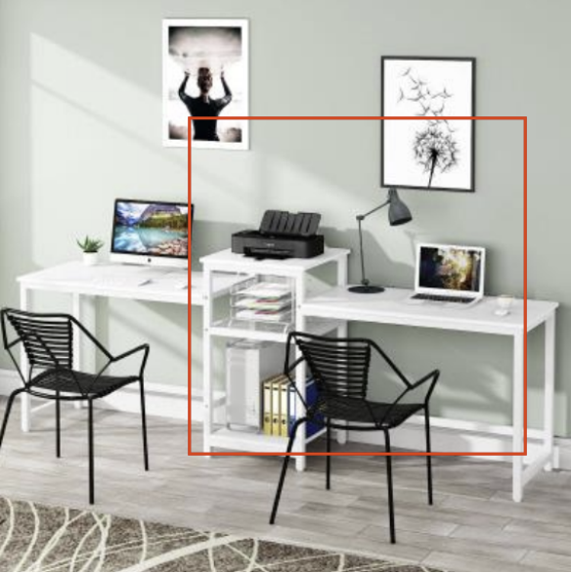
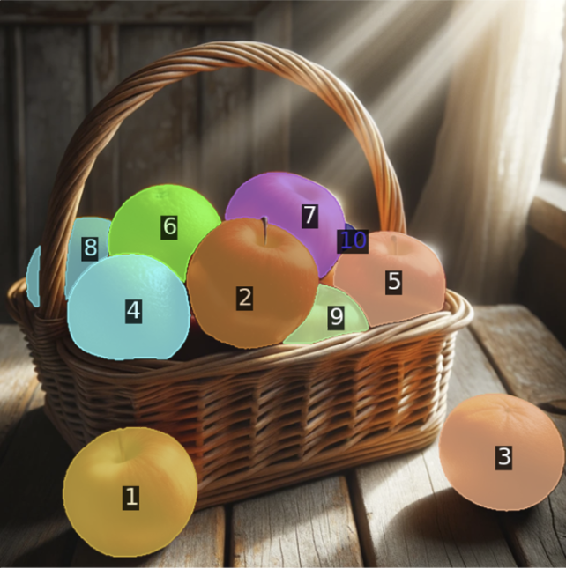
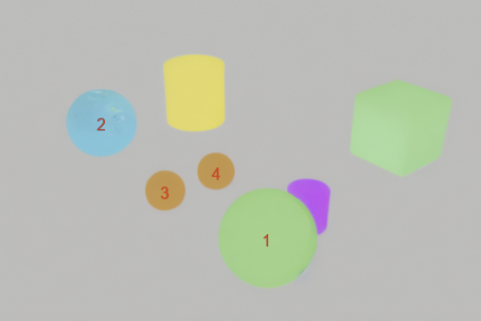
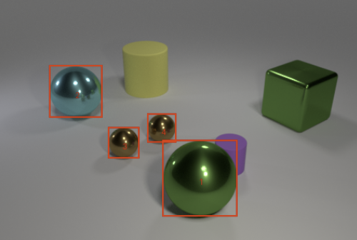
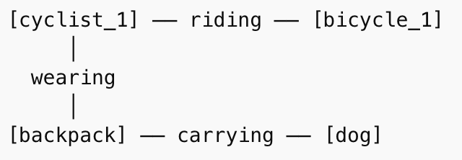
Past works on improving VLM’s for VQA
Vision-Language Decomposition [1]
Scene Graph Guided answering [2]
Cropping [3]
Visual Grounding [4]
[1]
Compositional Reasoning via Joint Image and Language Decomposition
Training-free Perception of Small Visual Details with Multimodal LLMs
Jiarui Zhang, Mahyar Khayatkhoei, Prateek Chhikara, Filip Ilievski ICLR 2025
[3]
Dwip Dalal*, Madhav Kanda*, Zhenhailong Wang, Heng Ji, Unnat Jain
EACL 2026
[2]
Compositional Chain-of-Thought Prompting for Large Multimodal Models
Chancharik Mitra, Brandon Huang, Trevor Darrell, Roei Herzig
CVPR 2026
[4]
Set-of-Mark Prompting Unleashes Extraordinary Visual Grounding in GPT-4V
Jianwei Yang, Hao Zhang, Feng Li, Xueyan Zou, Chunyuan Li, Jianfeng Gao
https://arxiv.org/abs/2310.11441

Slide 5

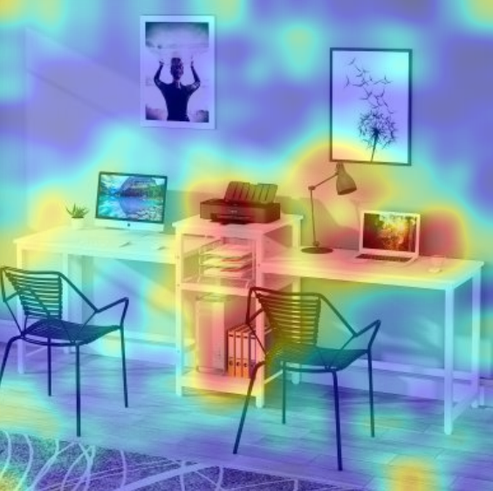
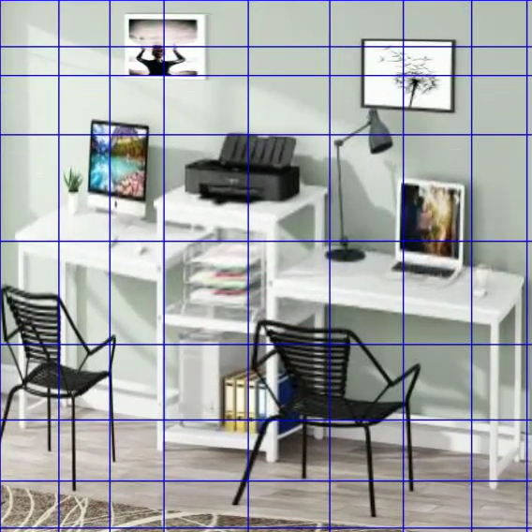
“On the right desk, what is to the left of the laptop?”
(Ours)
VLM (Image, Query): "To the left of the laptop there is a stack of books on the desk."
VLM (Warped Image, Query): "There is a lamp to the left of the laptop on the right desk."

Slide 6
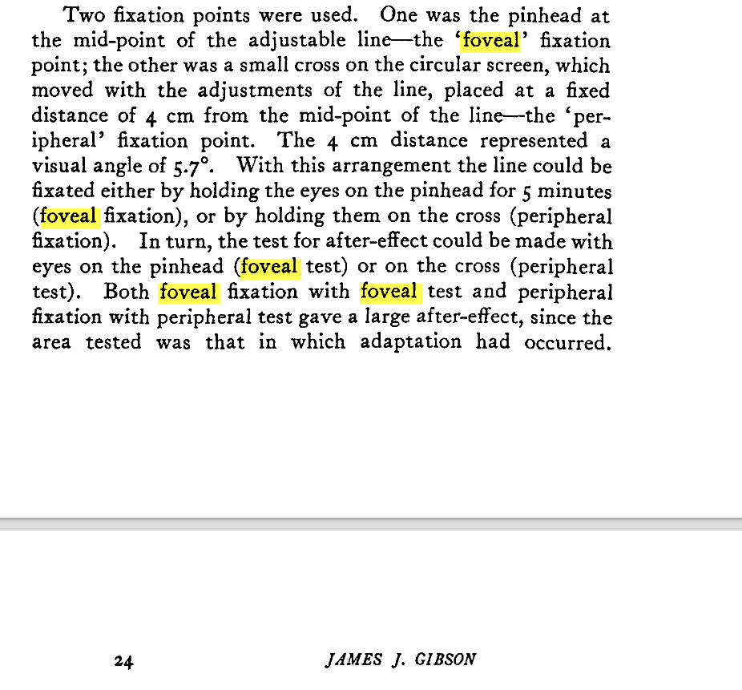


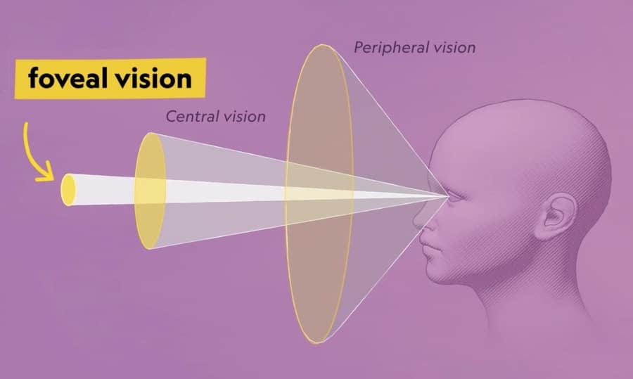
A new take at foveal vision
Gibson, James J. "Adaptation, after-effect and contrast in the perception of curved lines." Journal of experimental psychology 16.1 (1933)

Slide 7
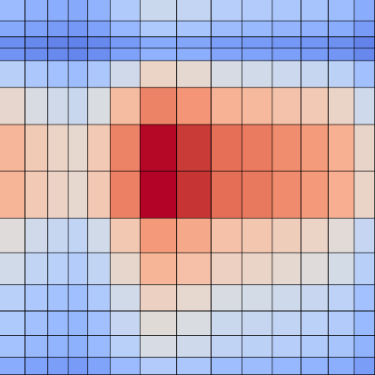

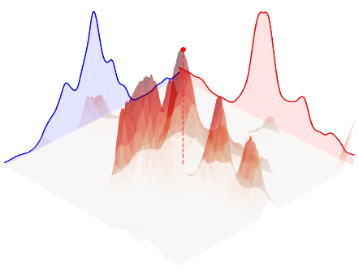

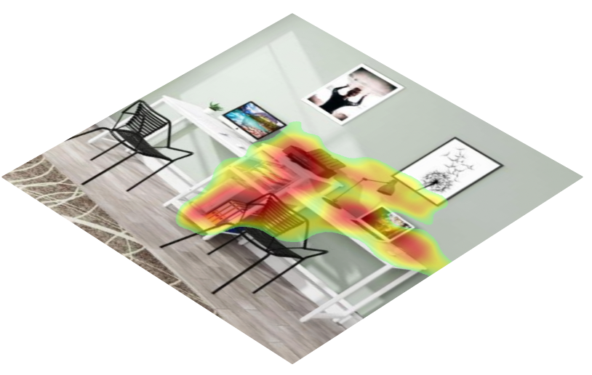
Attention-Guided Warping (AttWarp)
"On the right desk, what is to the left of the laptop?"
Warping Function
Image
Vision Model
Cross-modal attention
Attention Aggregation
from Language Decoder
VLM (Warped Image, Query):
"There is a lamp to the left of the laptop on the right desk."
Layers
Language Model

Slide 8
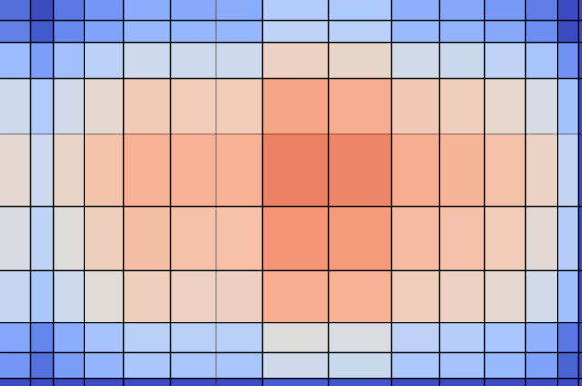
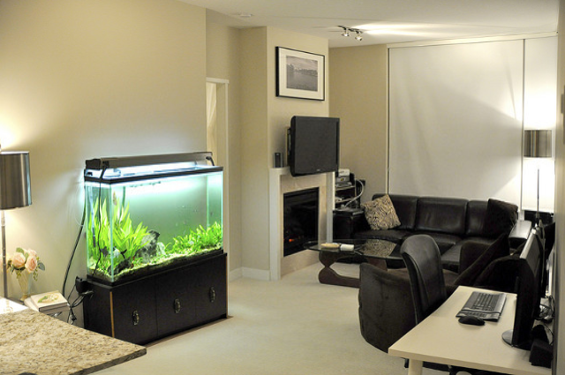
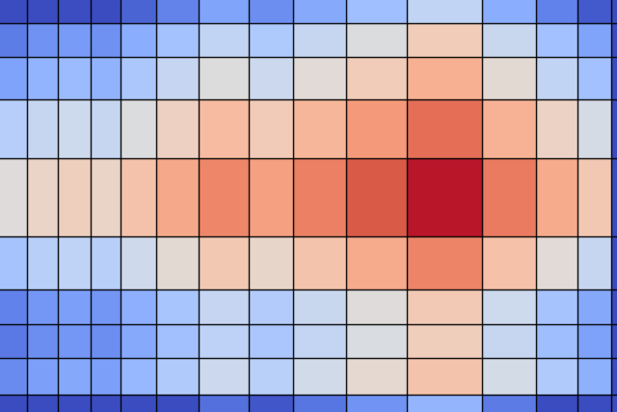



Attention-Guided Warping (AttWarp)
Query: What device is below the artwork?
LLaVA: Speaker
❌
AttWarp: Television
$$✅$$
Query: Is there a bottle in the image?
❌
$$✅$$
Qwen: No
AttWarp: Yes

Slide 9
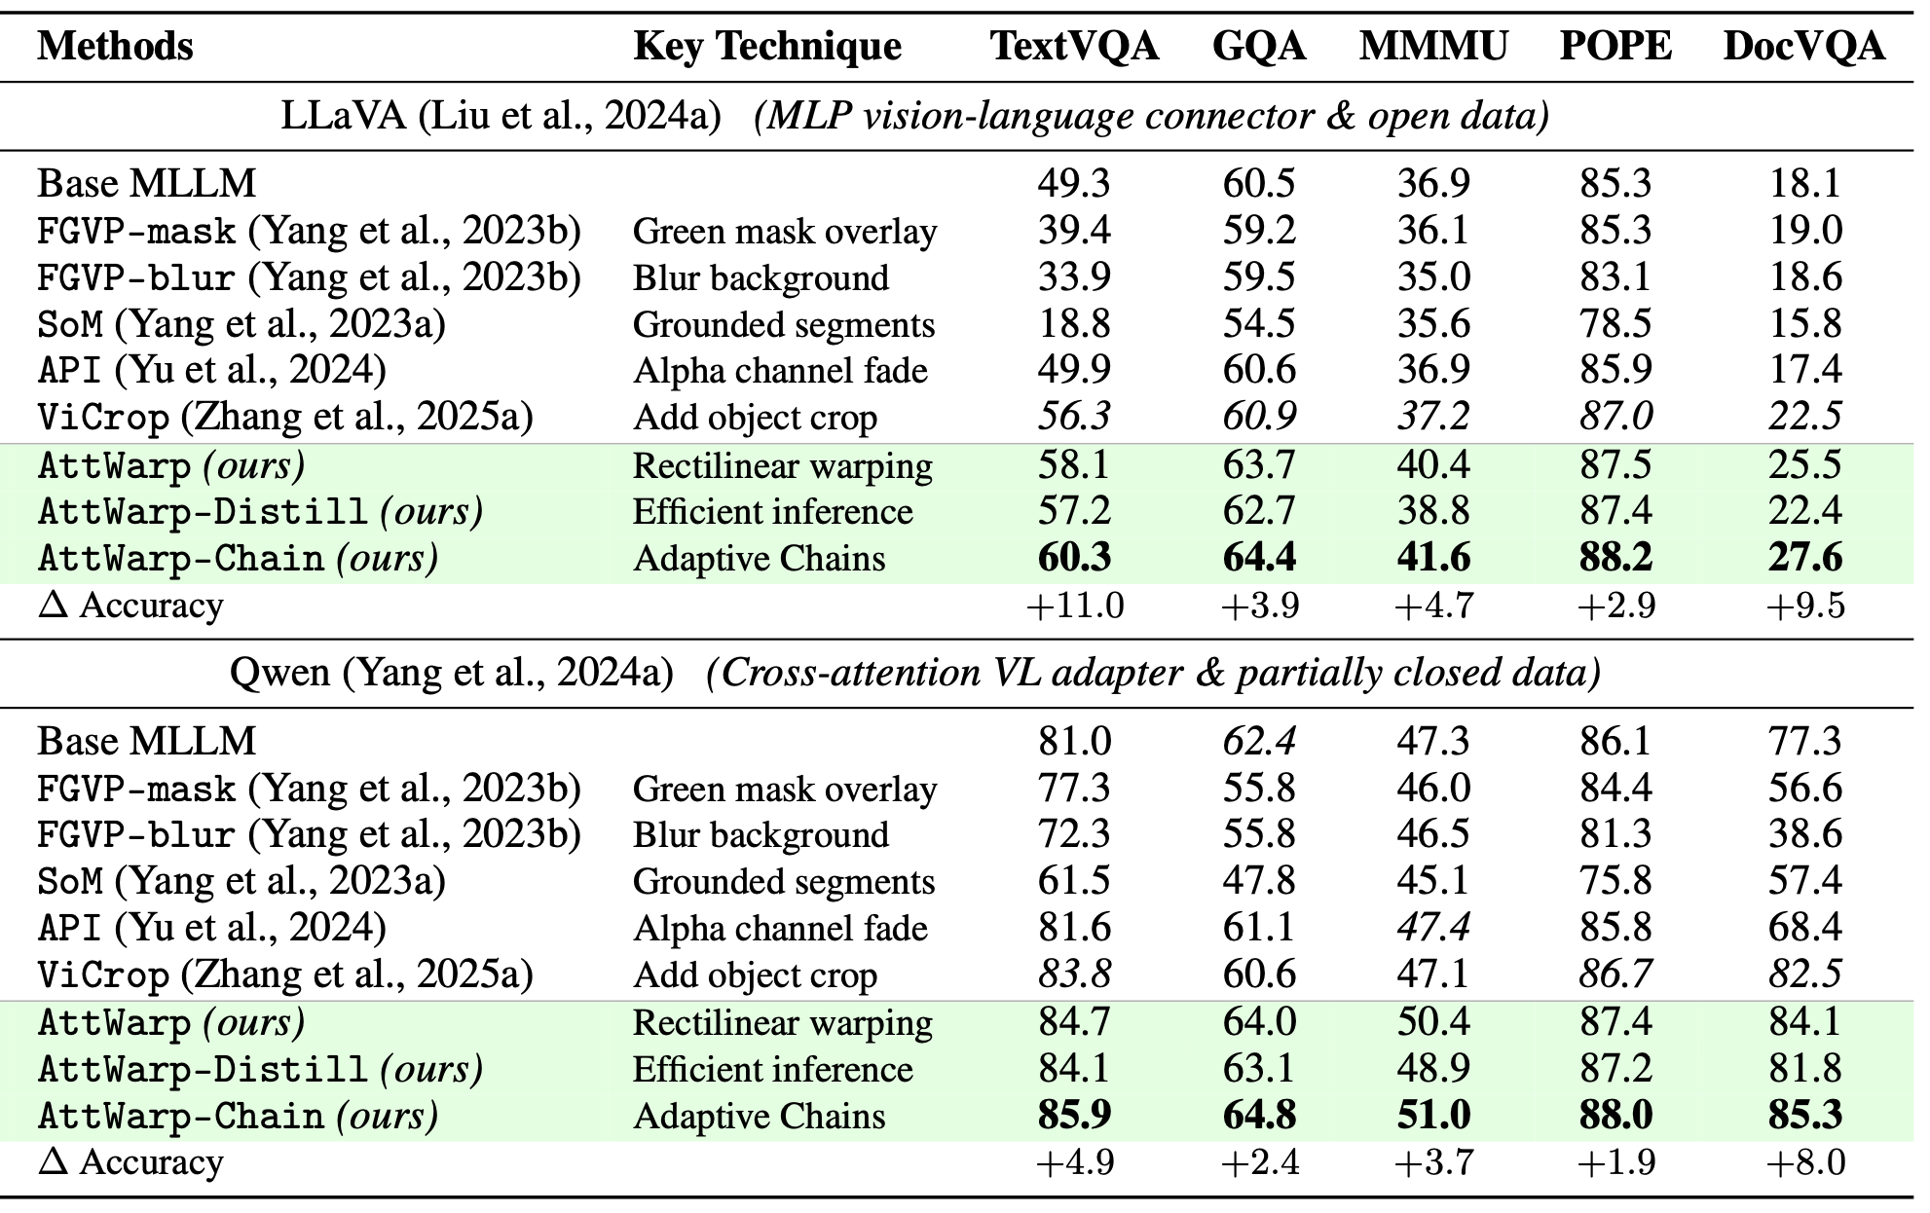
Warping helps across the board!

Slide 10
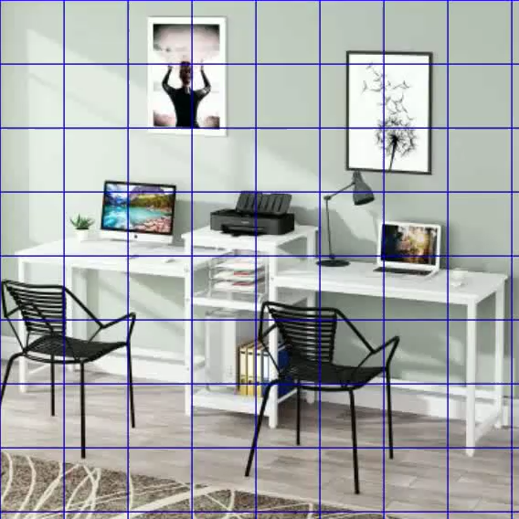
Attention-Guided Warping (AttWarp-Chain)
"On the right desk, what is to the left of the laptop?"
Warping Function
Query Specific Region Expanded
Image
Vision Model
Cross-attention
Attention Aggregation
from Language Decoder
VLM (Warped Image, Query):
"There is a lamp to the left of the laptop on the right desk."
Layers
Language Model

Slide 11
Attention-Guided Warping (AttWarp-Chain)
"On the right desk, what is to the left of the laptop?"
Warping Function
Query Specific Region Expanded
Image
Vision Model
Cross-attention
Attention Aggregation
from Language Decoder
VLM (Warped Image, Query):
"There is a lamp to the left of the laptop on the right desk."
Layers
Language Model

Slide 12
Warping w/ Chaining helps across the board!

Slide 13

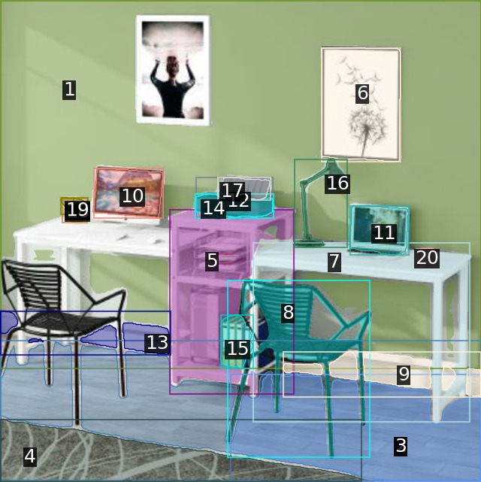

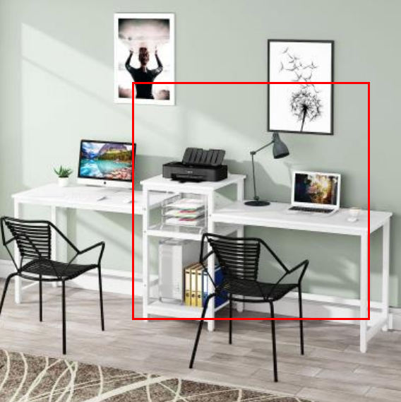
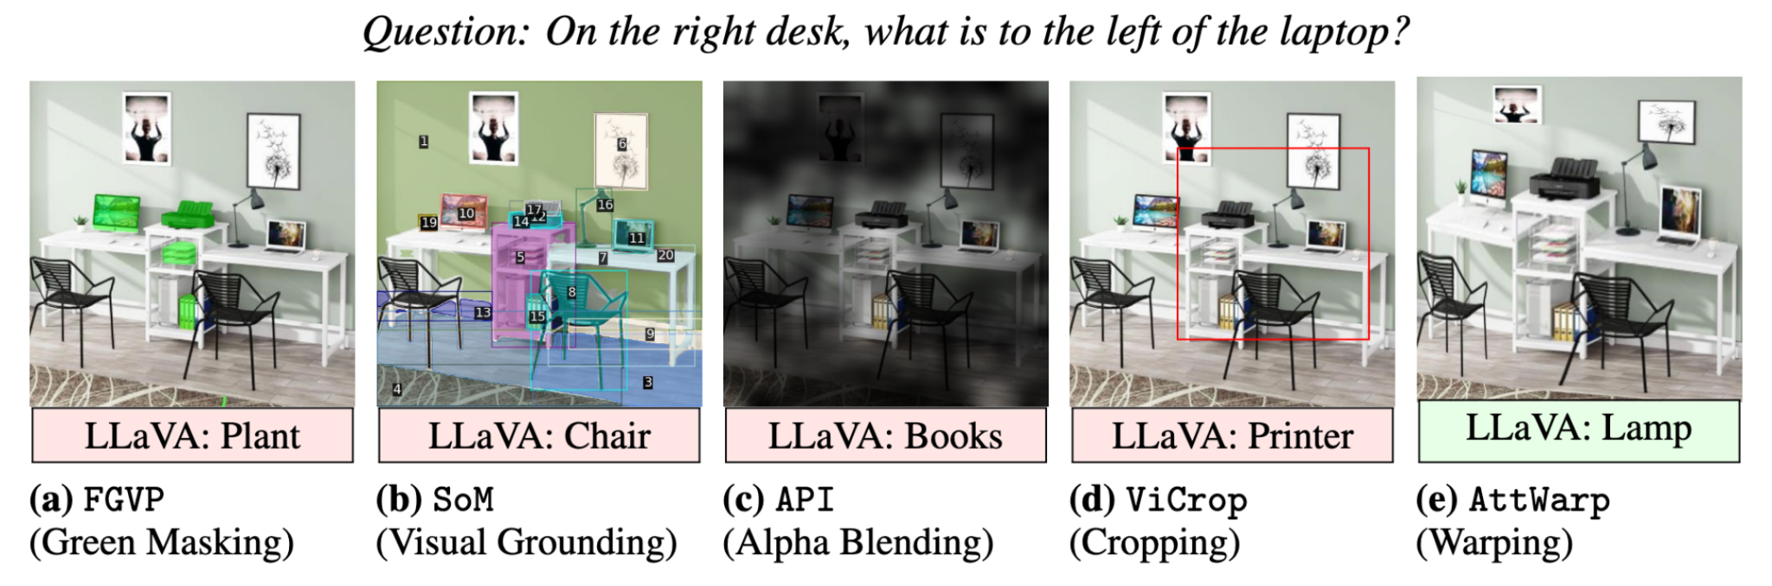
AttWarp vs. other distorted or augmented inputs

Slide 14
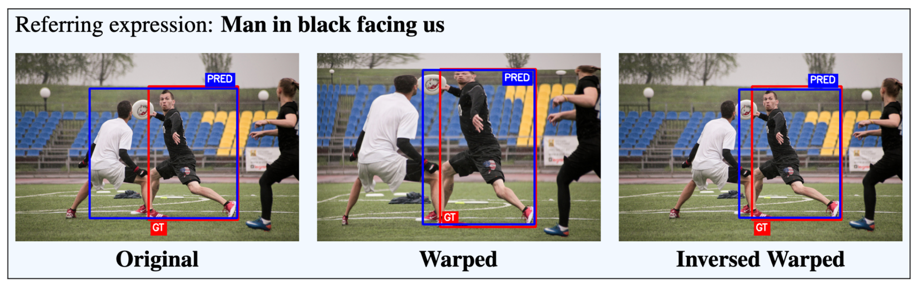
Same results for detection
LISA-7B: 54% on RefCOCO
LISA-7B + AttWarp: 61% on RefCOCO
Lai, Xin, Zhuotao Tian, Yukang Chen, Yanwei Li, Yuhui Yuan, Shu Liu, and Jiaya Jia. "Lisa: Reasoning segmentation via large language model." In Proceedings of the IEEE/CVF Conference on Computer Vision and Pattern Recognition, pp. 9579-9589. 2024.

Slide 15
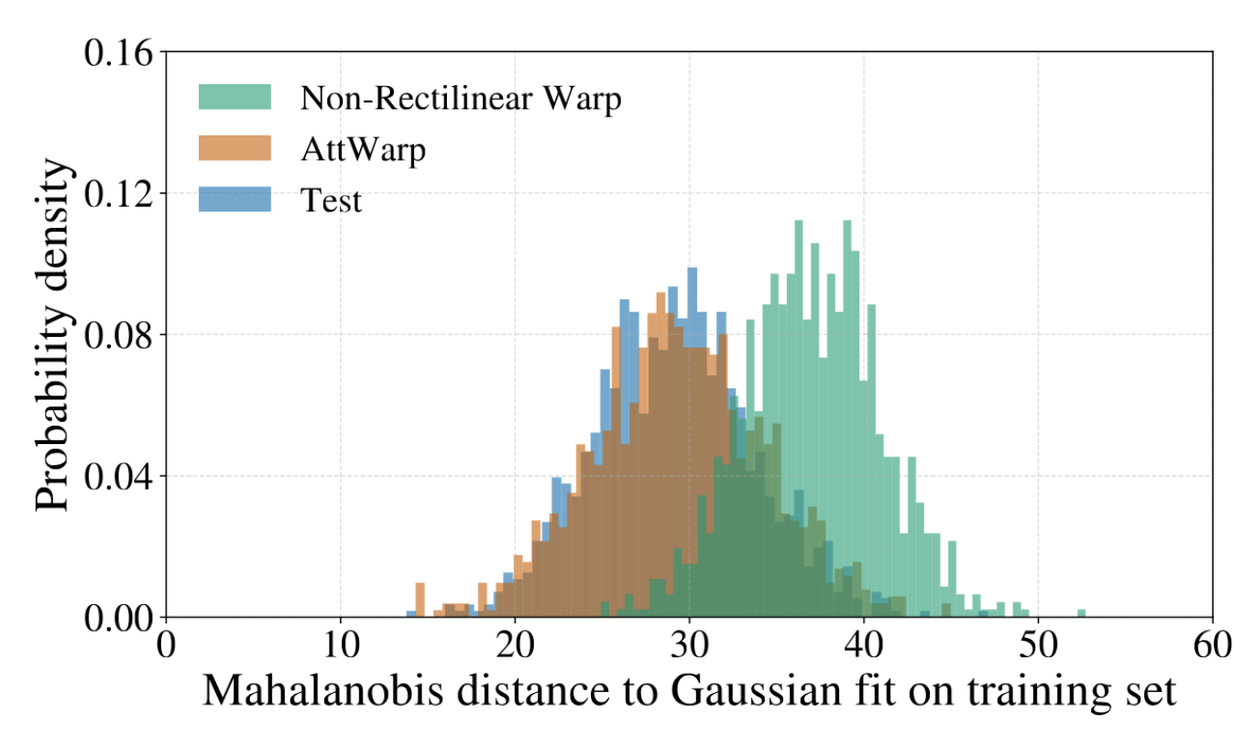
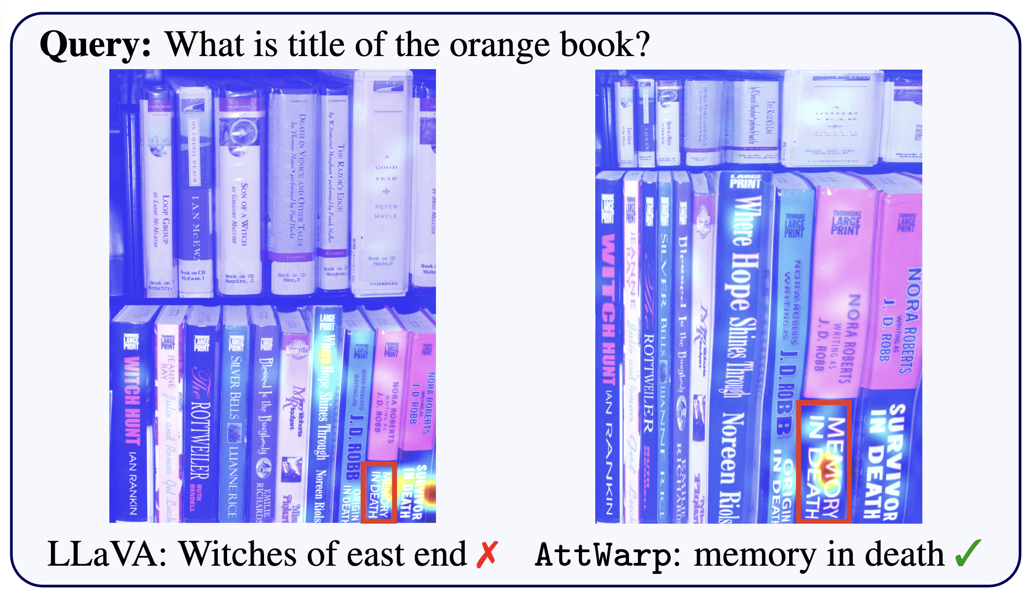
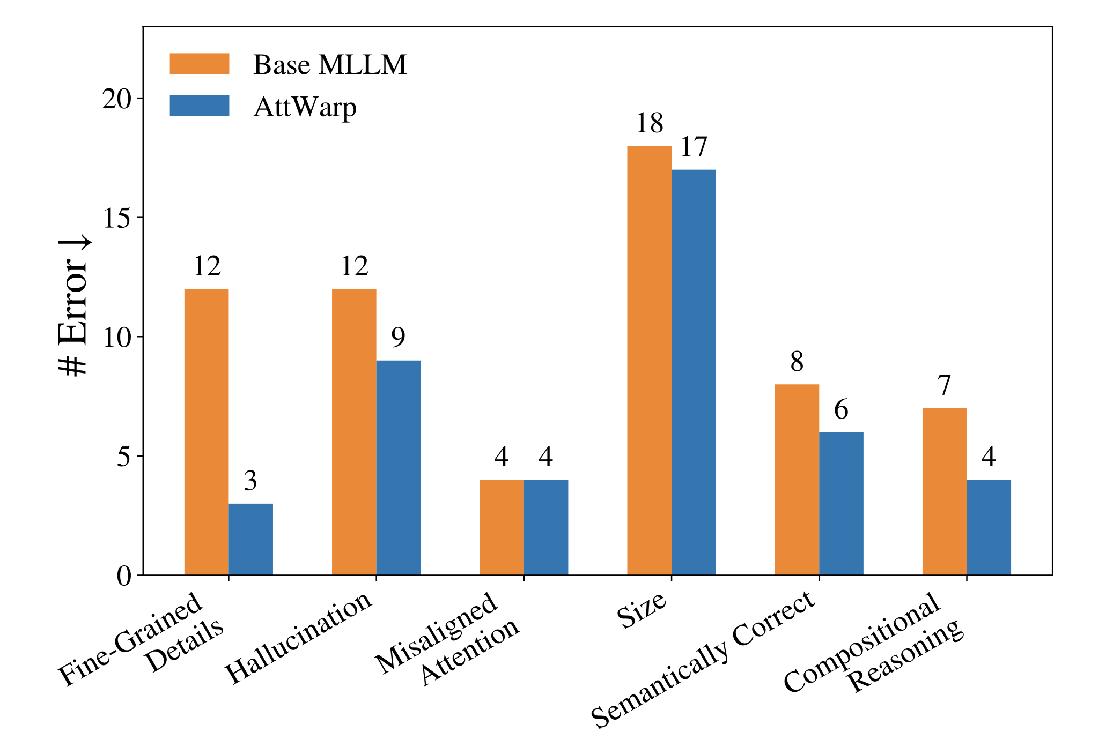
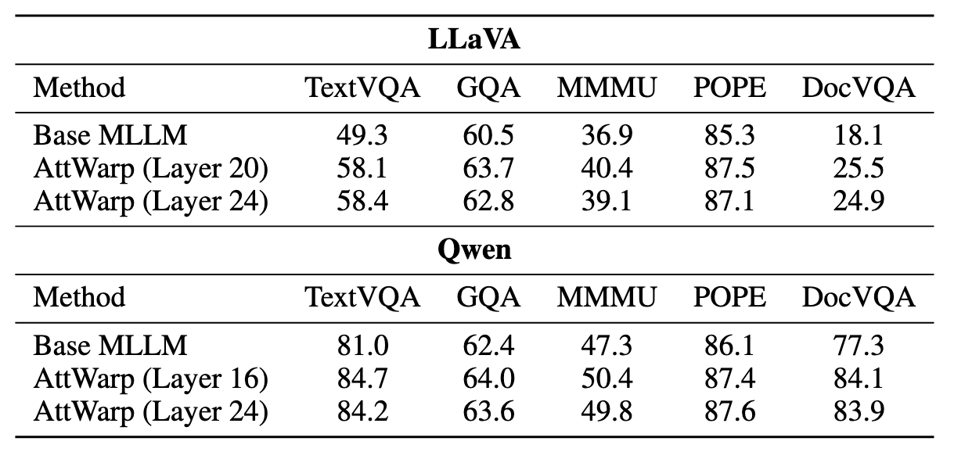
Insights
AttWarp improves attention
Rectilinear-ity is crucial
All failure modes go down
Robust to design choices

Slide 16
AttWarp
VLMs err even when they shouldn’t
Bridging cross-modal gap by warping images
Allocate more/less pixels to relevant/irrelevant regions
Tested, robust, intuitive, explainable

